Slide 2
Characteristics Of God:
Ability To Hear Prayer
Psalm 65:2 “O You who hear prayer, To You all flesh will come.”
Ability To Do Beyond Our Ability To Ask Or Think
Ephesians 3:20 “Now to Him who is able to do exceedingly abundantly above all that we ask or think, according to the power that works in us,”

Slide 3
Jesus Taught Disciples To Pray
Mark 11:24 “whatever things you ask when you pray, believe that you receive them, and your will have them.”
God’s “Ears” Are Open To The Prayers Of The Righteous
1 Peter 3:12 “His ears are open to their prayers”
James 5:16 “The effective, fervent prayer of a righteous man avails much.”

Slide 4
One Who Is Not A Christian, Who Does Not Believe In God, Cannot Make Use Of Prayer
1 Peter 3:12 “the face of the LORD is against those who do evil”
John 9:21 “we know that God does not hear sinners; but if anyone is a worshiper of God, and does His will, He hears him.”

Slide 5
ATTACKS ON THE CONCEPT OF PRAYER
Modernist: “"Prayer is only a psychological exercise, and its only value is that it is the expression of one's confidence,"
“Professing church members” – Do not make prayer a regular part of life
Spend less that five minutes a day
Evidence of a lack of faith

Slide 6
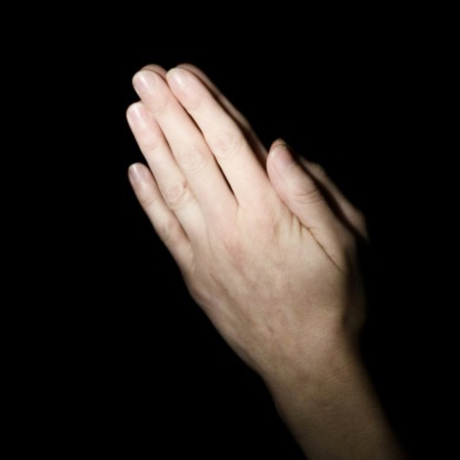
PRAYER IS A USELESS WASTE OF TIME

Slide 7
PRAYER IS USELESS WHEN OFFERED:
As A Substitute For Obedience To God’s Will
John 9:31 “does His will”
Where do we read in the N.T. of alien sinner being told, "pray to God that He will accept you as His child." Or, "pray the sinners prayer?”
Two Cases In Acts
Saul – 9:11
Cornelius – 10:2
Acts 22:16
Acts 10:48

Slide 8
PRAYER IS USELESS WHEN OFFERED:
The Sinner God Will Not Hear is The One Who Will Not Do His Will – John 9:31
Proverbs 28:9 “who turns away his ear from hearing the Law…”
Could be because of Ignorance – Romans 10:1-3
Others may be Rebellious – 2 Thessalonians 1:8
Acts 8:22 “Repent therefore of this your wickedness…”
1 John 1:9 “if we confess our sins, He is faithful and just to forgive…”
Psalm 66:18 “regard iniquity in my heart, the Lord will not hear.”

Slide 9
PRAYER IS USELESS WHEN OFFERED:
Without Effort On Our Part To Accomplish What We Can- “Why pray for what we can do?”
“Daily Bread” – Matthew 6:11
Have to WORK for it – 2 Thessalonians 3:10
“Wisdom” – James 1:5
Effort to study – 2 Timothy 2:15
For Spiritual Strength – Ephesians 3:16
Effort to let Christ Dwell in heart – Ephesians 3:17
Pray for the Lost – Romans 10:1
Make no effort to reach them- Romans 10:2-4
Pray for the needs of others – Make no effort to help – James 2:16

Slide 10
PRAYER IS USELESS WHEN OFFERED:
Without Effort On Our Part To Accomplish What We Can- “Why pray for what we can do?”
“Daily Bread” – Matthew 6:11
Have to WORK for it – 2 Thessalonians 3:10
“Wisdom” – James 1:5
Effort to study – 2 Timothy 2:15
For Spiritual Strength – Ephesians 3:16
Effort to let Christ Dwell in heart – Ephesians 3:17
Pray for the Lost – Romans 10:1
Make no effort to reach them- Romans 10:2-4
Pray for the needs of others – Make no effort to help – James 2:16
Pray as if it ALL DEPENDS ON GOD – And WORK as if it ALL DEPENDS ON YOU!

Slide 11
PRAYER IS USELESS WHEN OFFERED:
When offered by the Self-Righteous – Luke 18:11-14
Isaiah 64:6
When it comes From Wrong Motives – James 4:3
For Certain Ones – 1 John 5:16
James 4:19,20
Galatians 6:1
Prayer Involves God Working Through Providence
Forgiveness Requires Personal Repentance
“Sin unto death” involves an attitude toward any sin – 1 John 1:9
At The Wrong Time – Matthew 25:11; Luke 13:24-27
Luke 16:24

Slide 12
“ The effective, fervent prayer of a righteous man avails much.”
James 5:16
We can be Confident that God as our Father is willing to hear His children
Christ the Son is our Mediator
The Father hear Him Always
Will Grant things in keeping with His will and for the good of those “in Christ.”

Slide 13
Are Your Prayers “Useless?”
If You Have Never Obeyed The Gospel
You Do Not Have One To Intercede Before God!
OBEY!
Regarding Iniquity In Your Heart Makes Prayers Useless
Isaiah 55:6

